Slide 1
Youtube Data Analysis
Bowen Feng, Howard Hu, Jing Lin, Yu
Notes:
Hi guys I am Howard from youtube data analysis. Today I will talk about our project.

Slide 2

Introduction
Notes:
As people view videos online every day on websites such as Youtube, it is certainly important for us to know what they are watching and what they will watch. Part of the video has significantly more audiences than others, and we define those videos as trending videos. This analysis aims to produce a detailed analysis of the features of trending videos and some predictions about the popularity of a video.
This project aims for discovering the features and reasons behind the popular video based on the analysis of data from Youtube America. In the future people will want to know how far a video can go : how many views will it get? How many comments? Those are real life concerns attached to economical benefits. We would like to propose a prediction about the features of trending video using the dataset we processed. This would help the producer of the video to analyze their videos and make wiser decisions in future production.

Slide 3
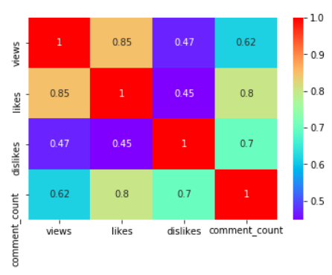
Heatmap for correlations of views, likes, dislikes, and comment_countfor correlations of views, likes, dislikes, and comment_count
Figure 6. Heatmap for correlations of views, likes, dislikes, and comment_count
Notes:
From the correlation heatmap we can see the how those features are related. To be more specific, we can see the views and likes are the most correlated with 85%. We would say the number of likes of a video has a positive relationship with its number of comments. Dislikes and the number of comments are correlated with 70%. Although the number of dislikes has a positive relationship with its number of comments, its relationship is weaker than the relationship between likes and comments. We can say that whether people like or dislike a video, it does not affect the decision of people who will or will not leave a comment under the video.

Slide 4
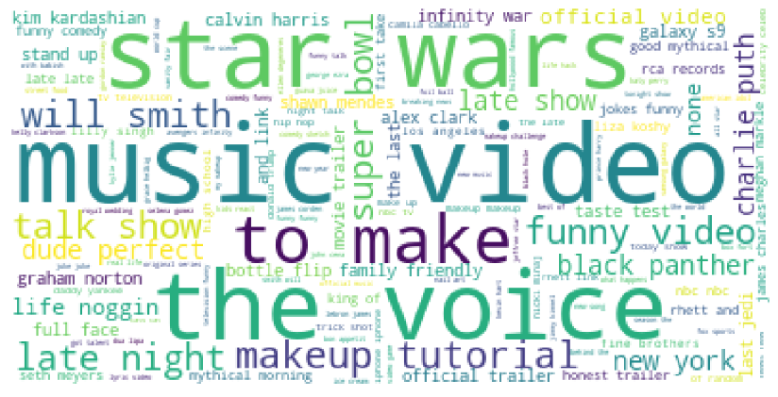
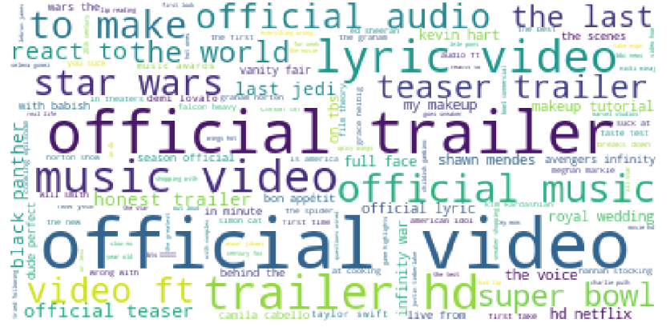
Figure 5. Titles Word Cloud
Figure 4. Tags Word Cloud
Notes:
Word cloud is something we find really helpful to visualize the statistics. We use a special tool we found to generate the word cloud to make the popularity of words in title or tags.The most trending word in tags word cloud is music video. The most trending wrod in titles word cloud is offical video.

Slide 5
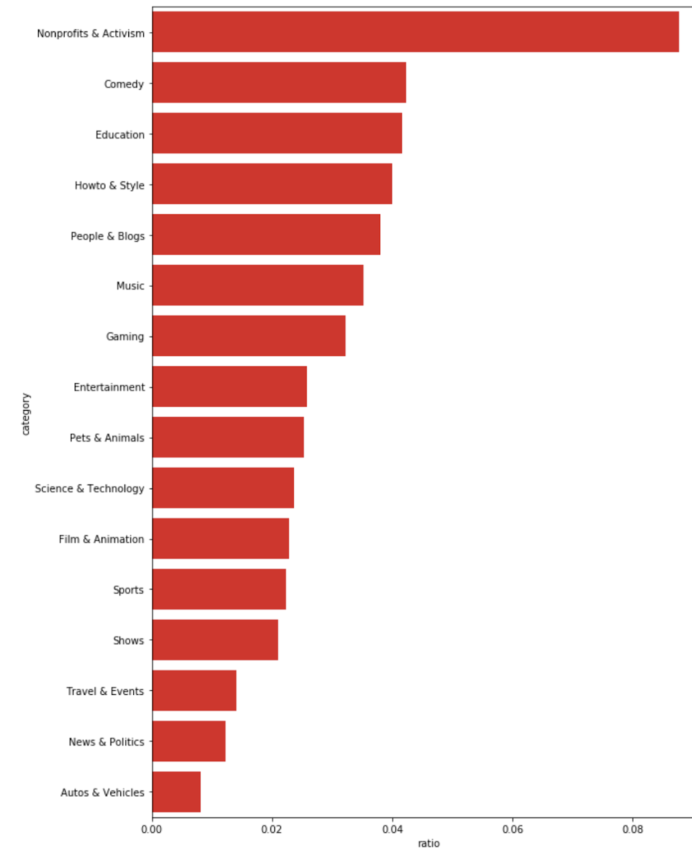
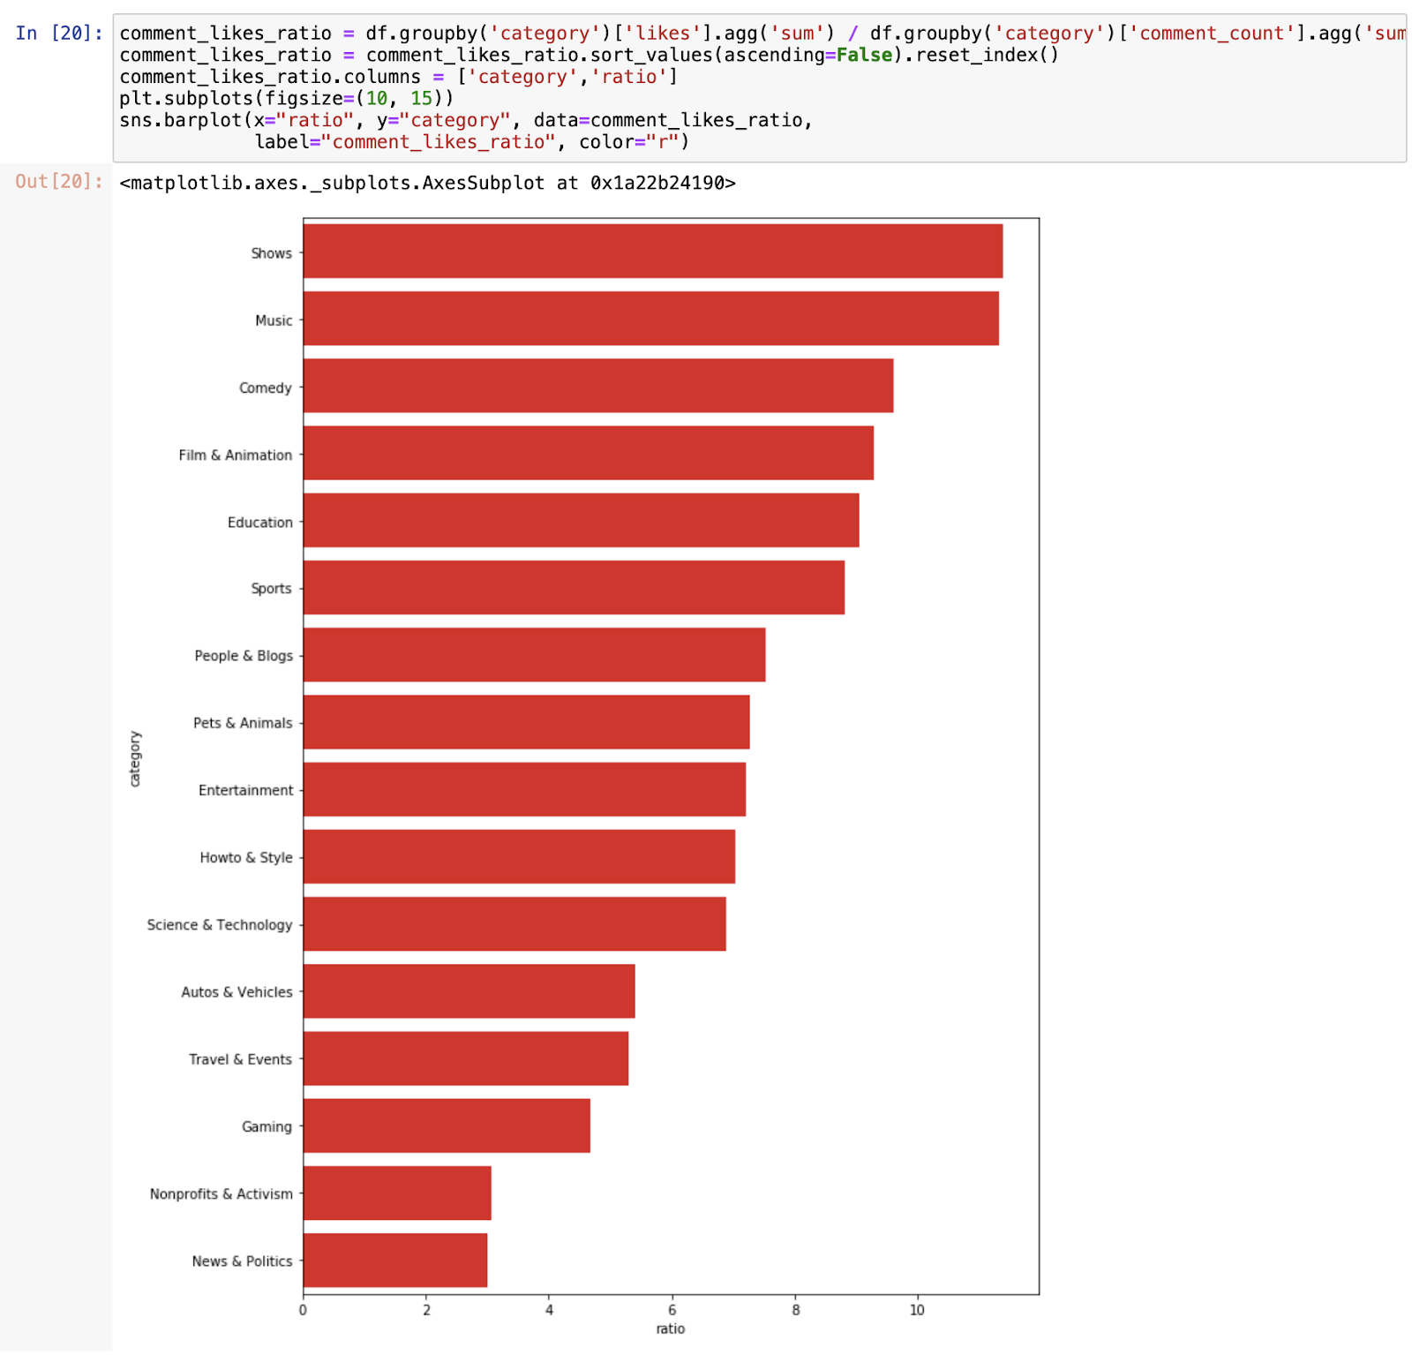
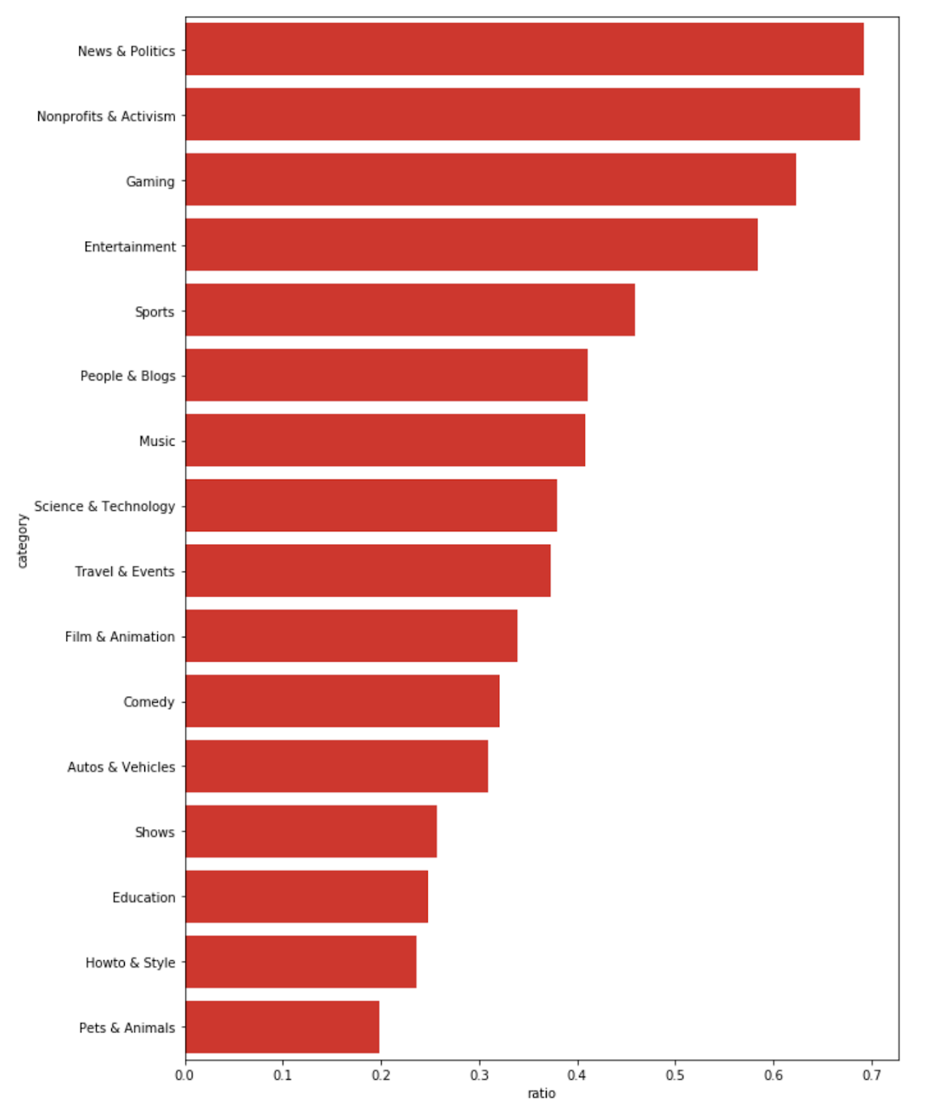
Barplot of Categories
Figure 7. Barplot of the categories based on likes-views ratio from highest to lowest.
Figure 8. Barplot of Categories based on likes-comments ratio from highest to lowest
Figure 9. Barplot of categories based on dislikes-comments ratio from highest to lowest
Notes:
the category with the highest likes-views ratio is Nonprofits and Activism, which makes sense since people would like to engage in nonprofits activities.
For the features of likes and comments, in figure 8, the category has the highest likes-comments ratio is Shows, which is reasonable since people would like to leave comments for their liked shows,
For the features of dislikes and comments, in figure 9, we found that the category with the highest dislikes-comment ratio is News & Politics which is understandable since people usually want to express their thoughts when they see disliked news or politics, and leaving a comment is also a way to receive options from other people.

Slide 6
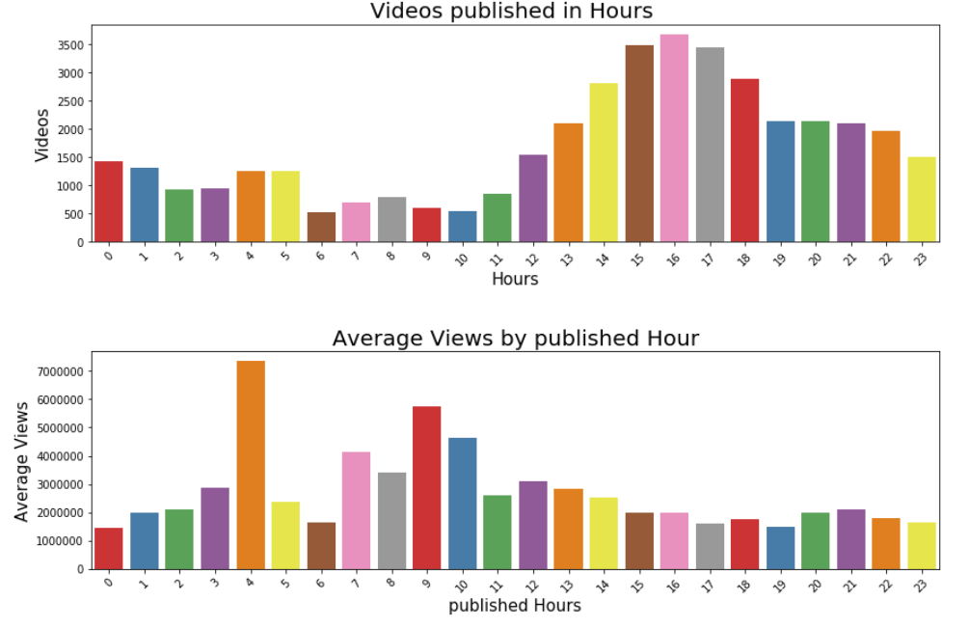
Barplots based on hour
Figure 10: Barplots based on the Hour
Notes:
We format the publish time into the date, hour, minute, and second. Then, we plot two bar graphs as shown in figure 10, the first graph shows how many videos published in the specific hour. As we can see from the graph, the videos published from 3 pm to 5 pm tended to become the Youtube trending video. The second graph shows the average views based on the published hours. We see from the graph that the video published at 4 am has the most views on average.

Slide 7
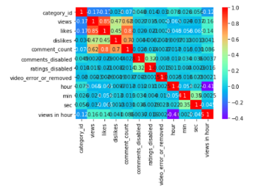
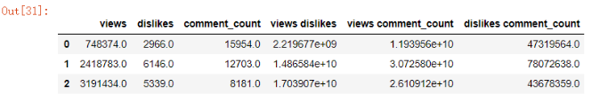
Feature Extraction
Notes:
By filtering out the correlation that is lower than 0.2, we only have three features left, views, dislikes, and comment_counts. Therefore, to improve the model accuracy or to obtain the most out of the three features, we decide to do feature engineering. The new dataset after feature engineering as shown in figure 12.

Slide 8
Results
Algorithms | Accuracy (Test error)
Linear Regression | 0.826
Ridge Regression | 0.836
Lasso Regression | 0.83
KNN regression(n_neighbors = 7) | 0.94
Decision tree (max_depth = 8) | 0.797
Table 1. The R-squared result from three models.
Notes:
We conjecture that KNN regression with 7 neighbors has the best accuracy for this dataset. The most surprising is the accuracy of the decision tree is even worse than linear regression. We would say the decision tree model is not a good choice for this situation.

Slide 9
Code Demo

